Slide 1

COMP 7500 Advanced Operating Systems
Lecture 16b
Project 3-4 AUbatch: Data Structures and Condition Variables
Xiao Qin
Auburn University http://www.eng.auburn.edu/~xqin
xqin@auburn.edu
Notes:
25 Min: Data structures: Slides 1-4
25 Min: Condition variables: Slides 5-12.
Cont. 13.

Slide 2
System Design
Data Flow Diagram
Function Prototypes
Program Structure
Data
Structures

Slide 3
Exercise 1: Data Structures
Please design data structures for the parameters in the above function prototypes.
Data Flow
Diagram
Function
Prototypes
Program
Structure
AUbatch: The Design of Data Structures

Slide 4
Condition Variables: cv_wait()
Reference: https://docs.oracle.com/cd/E19455-01/806-5257/6je9h032r/index.html
Notes:
Reference: https://linux.die.net/man/3/pthread_cond_wait

Slide 5
Condition Variables: cv_signal()
Reference: https://docs.oracle.com/cd/E19455-01/806-5257/6je9h032r/index.html

Slide 6
Condition Variables in OS/161
/* Release lock, put thread to sleep until cv is signaled; when thread wakes up again, re-acquire lock before returning */
void cv_wait(struct cv *c, struct lock *mutex);
/* If any threads are waiting on cv, wake up one of them. Caller must hold lock, which must be the same as the lock used in the wait call */
void cv_signal(struct cv *c, struct lock *mutex);

Slide 7
From AUbatch to the Producer/Consumer Problem
Notes:
Map AUbatch into the producer/consumer problem.

Slide 8
Producer/Consumer Implementation without Locks
char buffer[SIZE];
int count = 0, head = 0, tail = 0;
struct lock *mutex;
mutex = lock_create(“mutex for cv”);
void producer(char c) {
lock_acquire(mutex);
count++;
buffer[head] = c;
head++;
if (head == SIZE) {
head = 0;
}
lock_release(mutex);
}
char consumer() {
char c;
lock_acquire(mutex);
count--;
c = buffer[tail];
tail++;
if (tail == SIZE) {
tail = 0;
}
lock_release(mutex);
return c;
}

Slide 9
Exercise 2: How to handle the empty/full cases using locks?
void producer(char c) {
lock_acquire(mutex);
while (count == SIZE)
{
lock_release(mutex);
lock_acquire(mutex);
}
count++;
buffer[head] = c;
head++;
if (head == SIZE)
{
head = 0;
}
lock_release(mutex);
}
char consumer() {
char c;
lock_acquire(mutex);
while (count == 0) {
lock_release(mutex);
lock_acquire(mutex);
}
count--;
c = buffer[tail];
tail++;
if (tail == SIZE) {
tail = 0;
}
lock_release(mutex);
return c;
}
Which lock_acqure() and lock_release() are a pair?

Slide 10
Exercise 3: What’s the problem with the lock solution? How can you improve this code using wait and signal?
void producer(char c) {
lock_acquire(mutex);
while (count == SIZE)
{
lock_release(mutex);
lock_acquire(mutex);
}
count++;
buffer[head] = c;
head++;
if (head == SIZE)
{
head = 0;
}
lock_release(mutex);
}
char consumer() {
char c;
lock_acquire(mutex);
while (count == 0) {
lock_release(mutex);
lock_acquire(mutex);
}
count--;
c = buffer[tail];
tail++;
if (tail == SIZE) {
tail = 0;
}
lock_release(mutex);
return c;
}

Slide 11
How to use condition variables to wait?
void producer(char c) {
lock_acquire(mutex);
while (count == SIZE) {
cv_wait(notFull, mutex);
}
count++;
buffer[head] = c;
head++;
if (head == SIZE) {
head = 0;
}
cv_signal(notEmpty, mutex);
lock_release(mutex);
}

Slide 12
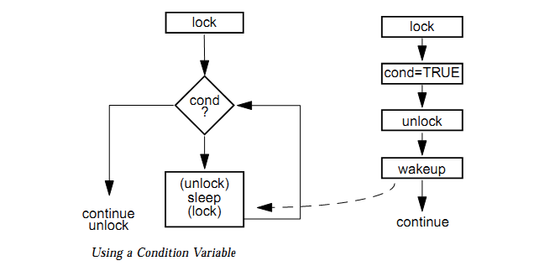
Condition Variables
Reference: http://blog.csdn.net/imyfriend/article/details/7590547

Slide 13

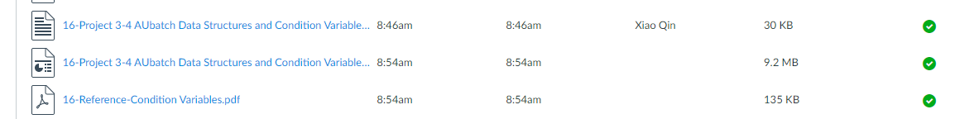
Summary
What’s the motivation of condition variables?
How to use condition variables?
Notes:
Cont. ch3.ppt, slide 44 Synchronization

